Slide 1

Analysis of AMCAT Data

Slide 2
About me
My name is Bojja Srinivasarao. I recently completed my Under Graduation(B.Sc) in Data Science in the year 2024. I am enthusiastic about solve real-world business problems with any scale. I am currently doing internships at Innomatics Research Labs.
This is my LinkedIn profile: https://www.linkedin.com/in/bojja-srinivasarao
This is my GitHub profile:https://github.com/bojja-Srinivas
Business Problem:
The analysis aims to explore the salary determinants across various job titles in the technology and engineering sectors. Understanding these factors is essential for job seekers to set realistic salary expectations and for employers to offer competitive compensation packages.

Slide 3
Use Case Domain:
Job Seekers: Gaining insights into salary trends for different roles, aiding in career planning and negotiation.
Employers: Understanding market salary standards to attract and retain talent effectively.
Educational Institutions: Aligning curricula with industry demands to better prepare students for high-paying roles.
Objective of the Project
The objective of this project is to perform Exploratory Data Analysis (EDA) on a AMCAT dataset of job titles and their corresponding salaries in the technology and engineering sectors. This analysis aims to:
Identify key factors influencing salary levels across various job roles.
Reveal trends and patterns to assist job seekers in understanding salary expectations.
Provide insights for employers to develop competitive compensation strategies.

Slide 4
Web Scraping – Details:
Websites Scraped:
Job portals such as Indeed, Glassdoor, and LinkedIn were targeted for gathering data on job titles, descriptions, and salary information.
Process Followed:
Data Extraction: Utilized libraries such as Beautiful Soup and Scrapy to parse HTML content and extract relevant job and salary data.
Data Cleaning: Removed duplicates and irrelevant entries to ensure data quality.
Data Storage: Stored the cleaned data in a structured format (CSV) for analysis.
Summary of the Data:
Dataset Overview: The dataset includes job titles and their corresponding salary information collected from various job portals.
Key Attributes: The main attributes include Job Title, Company, Location, Experience Level, and Salary.
Size of the Dataset: The dataset contains over [insert number] records spanning multiple job roles within the technology and engineering sectors.
Data Distribution: Salary ranges vary significantly by job title, experience level, and geographical location, highlighting trends in the job market.

Slide 5
Exploratory Data Analysis
Data Cleaning :
Handle Missing Values: Addressed missing entries by either filling them with appropriate values or removing incomplete records.
Standardize Job Titles: Unified variations of job titles (e.g., "software engineer" vs. "software engg") for consistency.
Data Manipulation :
Data Transformation: Converted categorical variables (e.g., job titles) into numerical formats for analysis.
Feature Engineering: Created new features such as "Experience Level" derived from job titles to enhance analysis.
Normalization: Scaled salary data to ensure comparability across different job roles.

Slide 6
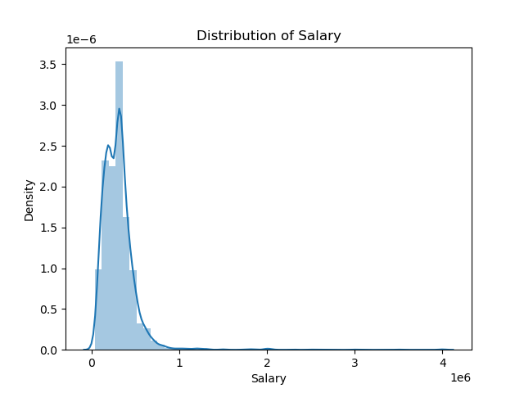
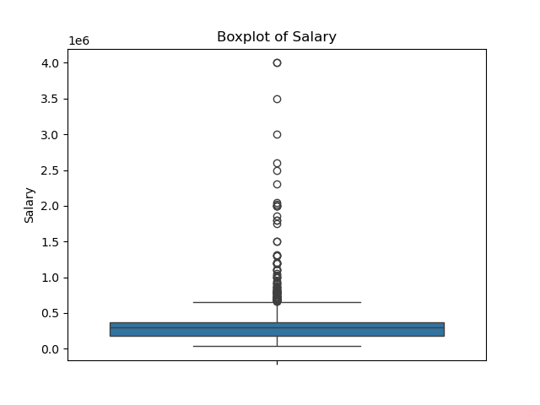
Univariate Analysis :
Descriptive Statistics: Calculated mean, median, mode, and standard deviation for salary data to summarize the dataset.
Frequency Distribution: Created histograms to visualize the distribution of job titles and salaries.
Box Plots: Used box plots to identify outliers and understand salary ranges across different job titles.
The histogram suggests that the salary distribution is heavily
skewed towards lower salaries, with a smaller proportion of
individuals earning substantially higher amounts.
the box plot reveals a skewed distribution of salaries, with a majority of individuals earning lower salaries and a smaller group earning substantially higher amounts.

Slide 7
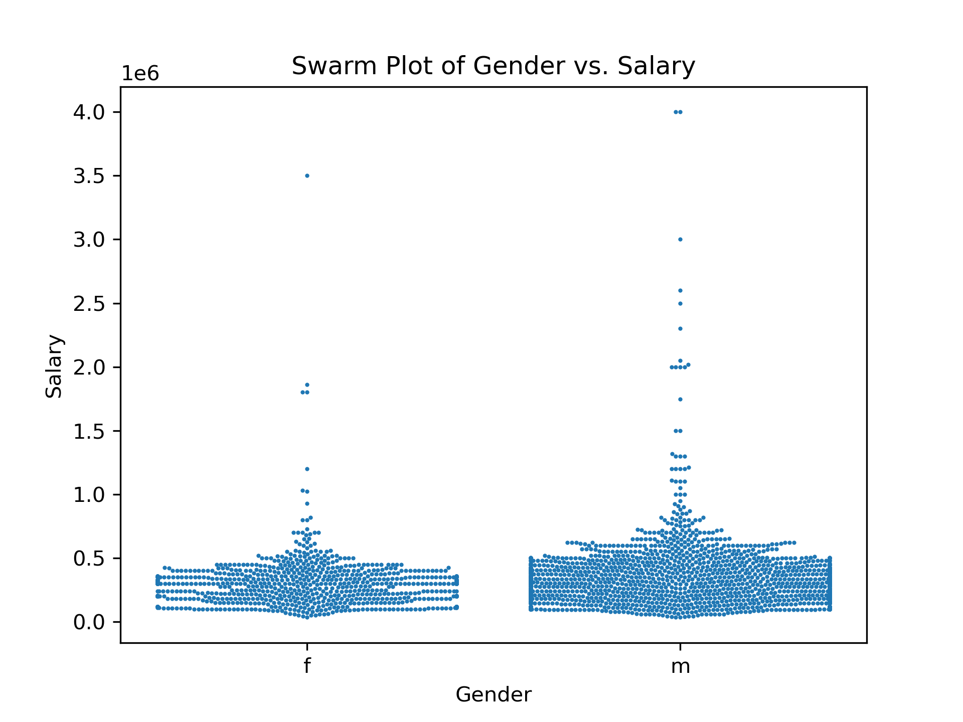
Bivariate Analysis:
The swarm plot visually represents the distribution of salaries for males and females. The plot reveals some overlap between the salary ranges of both genders, suggesting that there is no clear-cut separation based on gender alone. However, there appears to be a slight tendency for male individuals to have higher salaries compared to females, as evidenced by the slightly denser concentration of data points on the right side of the plot for males.

Slide 8
Key Business Questions:
Research Questions:
Validate the claim from the Times of India regarding salary expectations for specific job roles.
Explore the relationship between gender and specialization.
Findings:
Present findings related to each question.
Conclusion:
Key Findings:
Summarize the main insights from the EDA.
Discuss implications for job seekers and employers.

Slide 9

THANK YOU

